Slide 1
Pixenchar

Slide 2
Index
Abstract
Use Cases
Implementation
Results
Conclusion

Slide 3
Team Details
Sr. no. | Name | Enrolment no.
1 | Divyesh Patel | 200103062020
2 | Abhay Pisharodi | 200103062024
3 | Sama Mustufa | 200103062027
4 | Parth Panchal | 210133062006

Slide 4
Abstract
Image is a 3 channel matrix with i row and j column, where 3 channel belongs to the color Red, Green, Blue; this color, ranges from 0 to 255 in each cell of every channel. PixEnchar is the model derived from the ESRGAN architecture which enhance the image resolution. To add some more on to it we have added a custom dpi option as well as static dpi through which user can easily change by just add the expected value. Moreover, it can process on mass images efficiently in short time.

Slide 5
Use cases

Slide 6
Project details
We have used the following tools, language, utilities:
Python: os, pillow (libraries)
Vulcan engine (for GPU on both win / unix)
ESRGAN model (TensorFlow)
References
TensorFlow ESRGAN: Image Super Resolution using ESRGAN | TensorFlow Hub
Vulcan Engine: NightmareAI/Real-ESRGAN: Real-ESRGAN aims at developing Practical Algorithms for General Image/Video Restoration. (github.com)
OS module: os — Miscellaneous operating system interfaces — Python 3.11.4 documentation
Pillow: Pillow (PIL Fork) 10.0.0 documentation

Slide 7
implementation
The First Step is to place the desired input into the input folder.
Run the code Which uses ESRGAN algorithm which will change the scale resolution and regenerate the image.
After Generating that Image it would be saved into the output folder.
We are also able to set our custom DPI according to the system convinence.

Slide 8
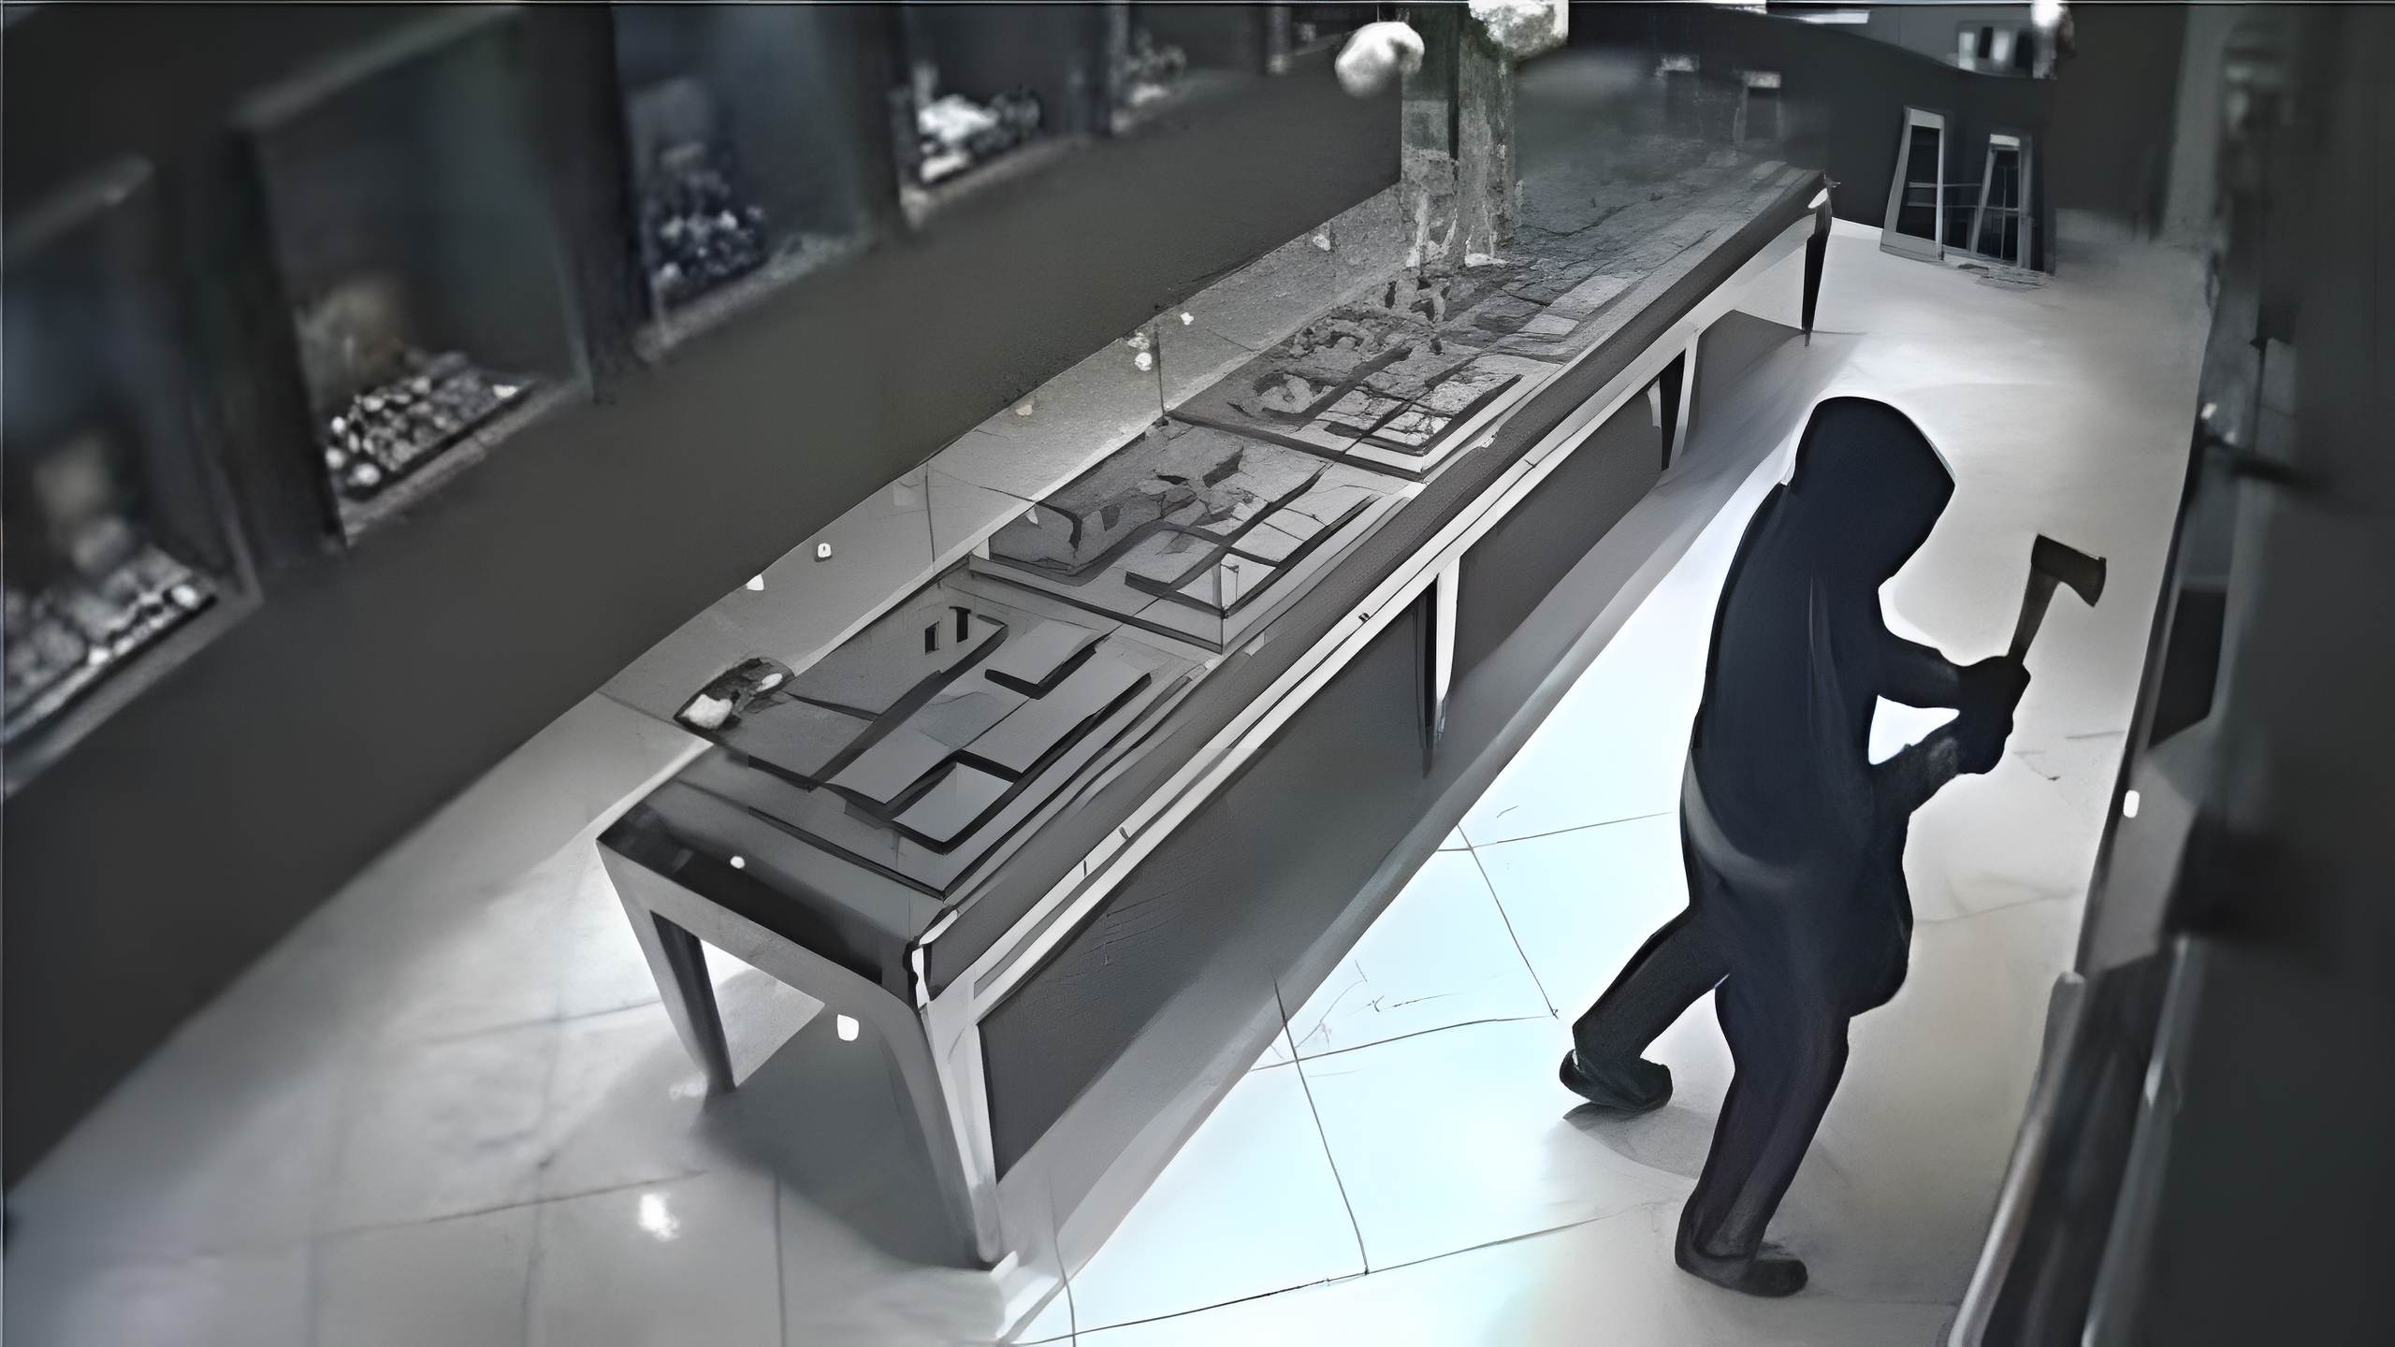
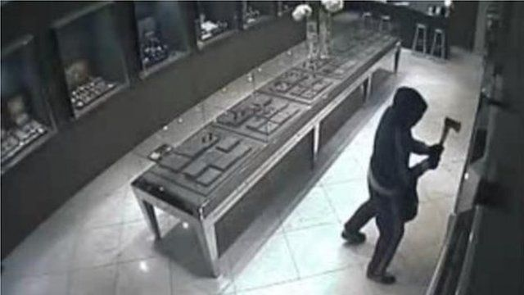
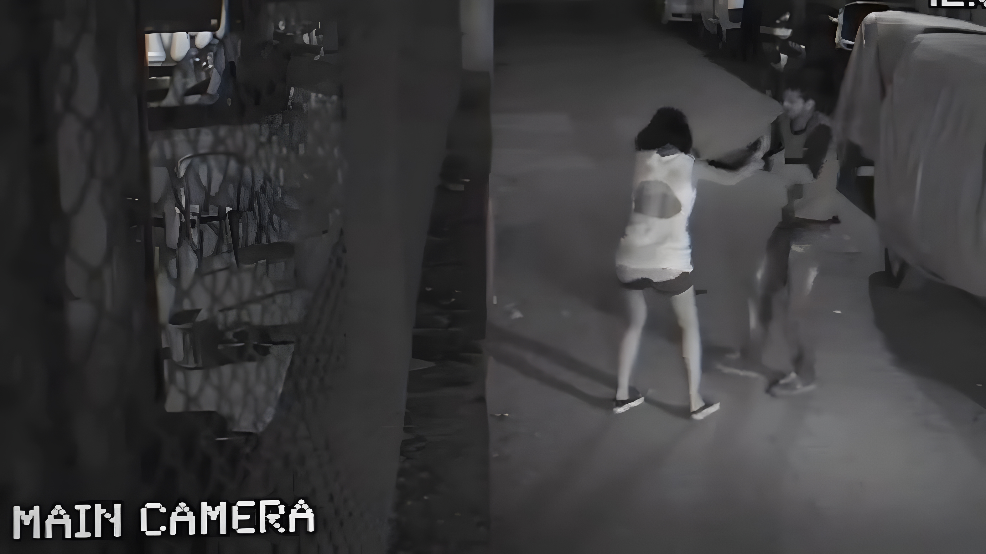
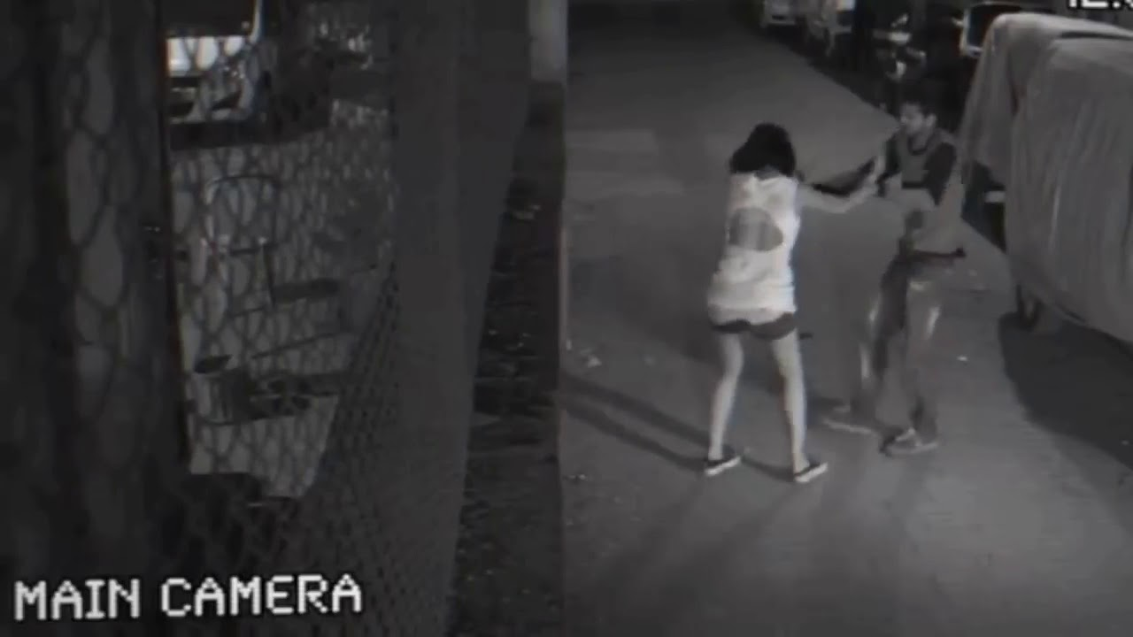
Results
Output Image
Input Image

Slide 9
Conclusion
As these images are regenerated they are more clear and smoother as the noise is reduced along with the enhancement of the image, more crisp image is seen in output.

